Slide 1
Thermal Energy

Slide 2
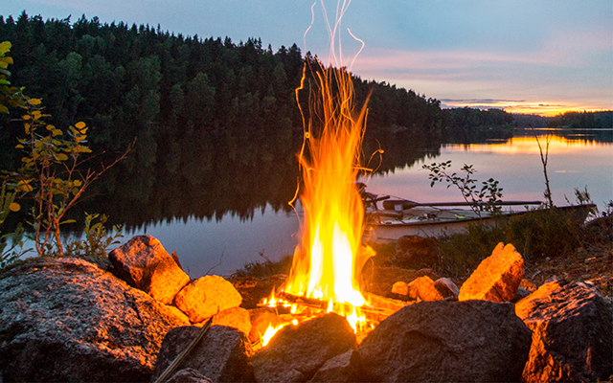
Learning Objectives
CFU
What are we going to learn?
Define thermal (heat) energy.
Explain thermal equilibrium.
Compare the amount of thermal energy in objects.
Activate Prior Knowledge
Many objects contain or produce heat energy.
On your whiteboard, list 5 objects that contain or produce heat.

Slide 3
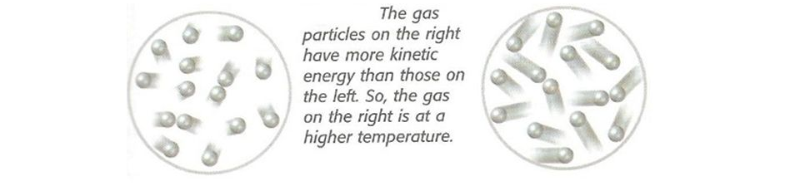
Concept Development
CFU 1
What is thermal energy?
Thermal (or heat) Energy
Thermal energy is the energy of moving/vibrating particles.
It is related to the temperature of the object.
The hotter an object, the more kinetic energy the particles inside the object have, therefore the more thermal energy the object has.
CFU 2
How is thermal energy related to temperature?

Slide 4
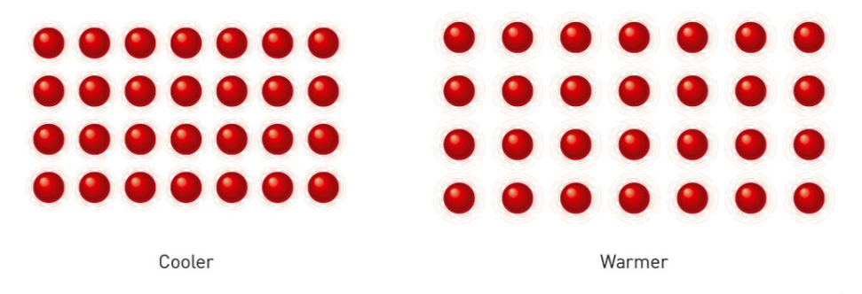
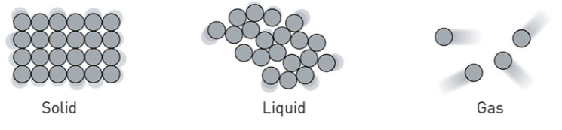
Concept Development
CFU 1
What happens when the particle have more energy?
Thermal (or heat) Energy
When the particles move faster, they collide with more energy and push each other further apart.
The particles in the object take up more space, so the object expands.
When enough thermal energy is transferred to the object, a change of state may occur.
CFU 2
What happens to the object as a whole if enough energy is applied?

Slide 5
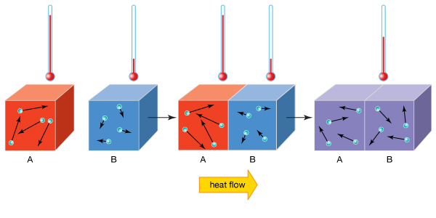
Concept Development
CFU 1
What happens when you put a hot object in cold water?
Thermal Equilibrium
If you put a hot object into a bucket of cold water, the temperature of both objects changes.
Thermal energy will transfer from the object, which is a higher temperature, to the water.
The object becomes cooler and the water becomes hotter.
Eventually, both objects will reach the same temperature, and the transfer of energy will stop.
When thermal energy is balanced with its surroundings, it is called thermal equilibrium.
CFU 2
Which way does the heat energy flow?
CFU 3
What is meant by the phrase thermal equilibrium?

Slide 6
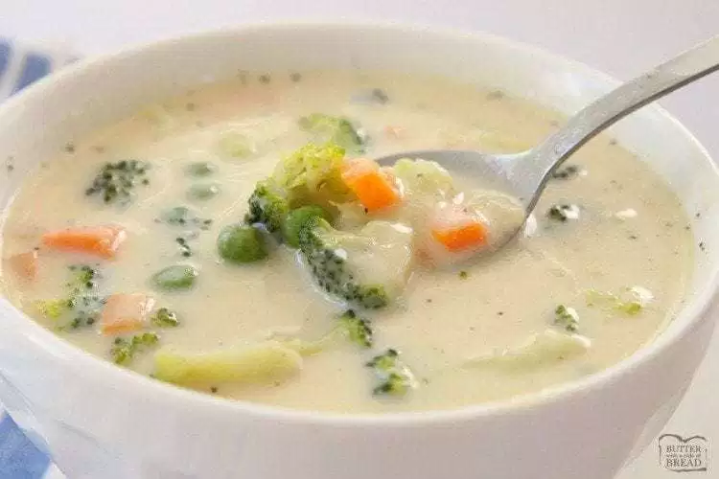
Skill Development/Guided Practice
CFU 1
Which object has higher thermal energy?
Describing Heat Transfer
Identify the object with higher thermal energy. State the direction of energy transfer. Describe what will happen to the temperature of the objects.
You place a spoon in hot bowl of soup.
CFU 2
Which way will energy be transferred?
The soup has higher thermal energy and will transfer heat to the spoon.
The spoon gains heat from the soup until they are the same temperature.
CFU 3
What will happen to the temperatures of the objects?

Slide 7
Skill Development/Guided Practice
CFU 1
Which object has higher thermal energy?
Describing Heat Transfer
Identify the object with higher thermal energy. State the direction of energy transfer. Describe what will happen to the temperature of the objects.
You leave your soup for a while, so you can call a friend.
CFU 2
Which way will energy be transferred?
The soup has higher thermal energy and will transfer heat to the air.
The soup loses heat to the air until they are the same temperature.
CFU 3
What will happen to the temperatures of the objects?

Slide 8
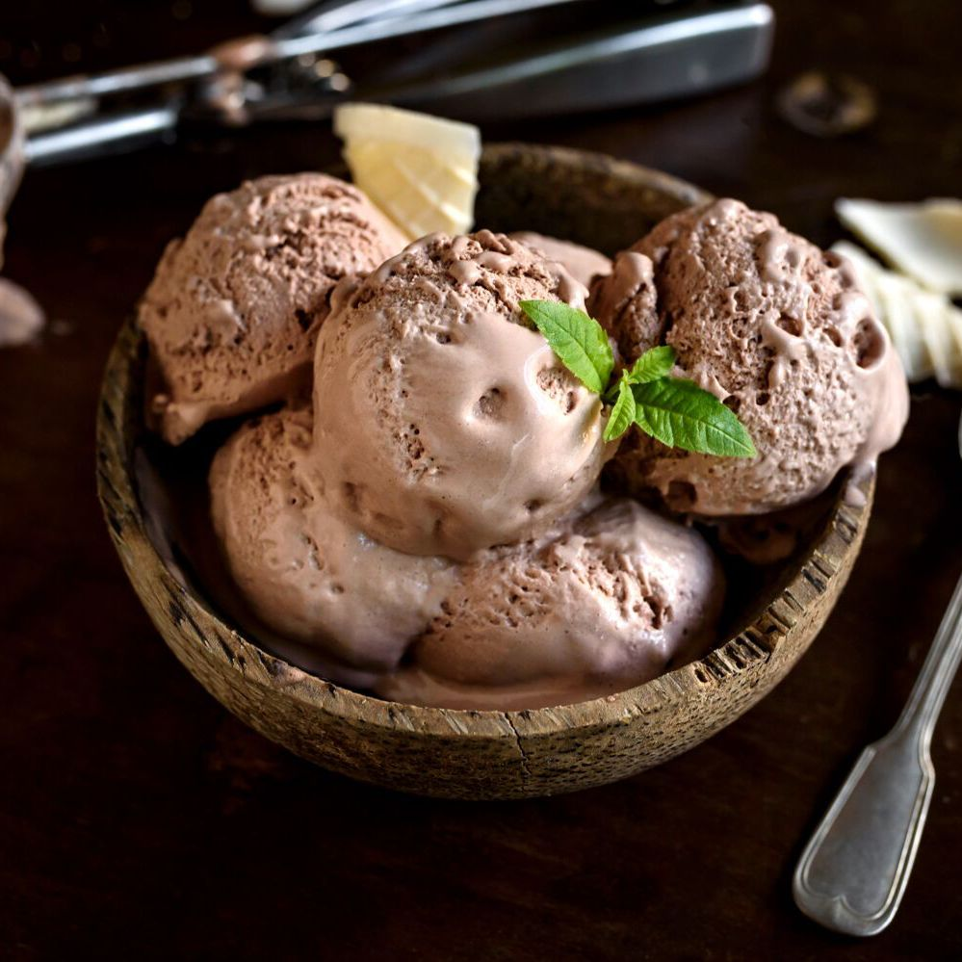
Skill Development/Guided Practice
CFU 1
Which object has higher thermal energy?
Describing Heat Transfer
Identify the object with higher thermal energy. State the direction of energy transfer. Describe what will happen to the temperature of the objects.
Ice cream starts to melt on a hot day.
CFU 2
Which way will energy be transferred?
The air has higher thermal energy and will transfer heat to the ice cream.
The ice cream gains heat from the air until they are the same temperature.
CFU 3
What will happen to the temperatures of the objects?

Slide 9
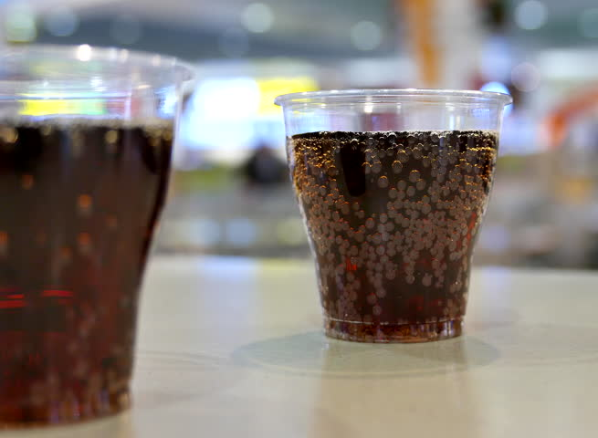
Skill Development/Guided Practice
CFU 1
Which object has higher thermal energy?
Describing Heat Transfer
Identify the object with higher thermal energy. State the direction of energy transfer. Describe what will happen to the temperature of the objects.
You leave a glass of coke by the pool while you go for a swim.
CFU 2
Which way will energy be transferred?
The _____ has higher thermal energy and will transfer heat to ____________. The ________ gains heat from the _______ until they are the same temperature.
CFU 3
What will happen to the temperatures of the objects?

Slide 10
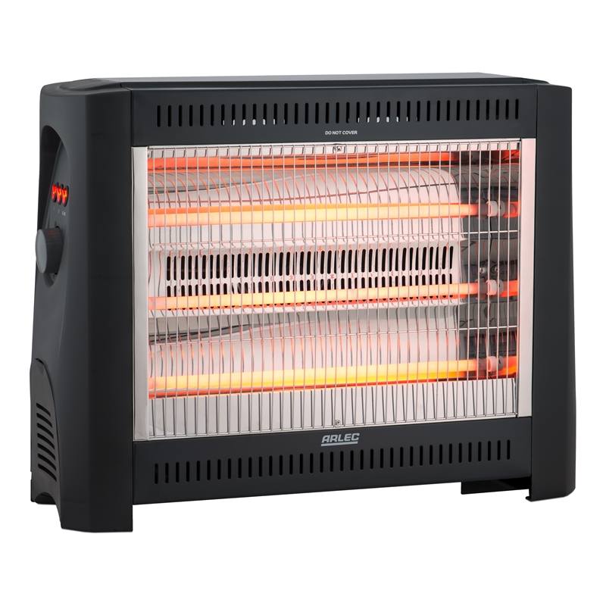
Skill Development/Guided Practice
CFU 1
Which object has higher thermal energy?
Describing Heat Transfer
Identify the object with higher thermal energy. State the direction of energy transfer. Describe what will happen to the temperature of the objects.
You turn on a heater in your bedroom.
CFU 2
Which way will energy be transferred?
The _____ has higher thermal energy and will transfer heat to ____________. The ________ gains heat from the _______ until they are the same temperature.
CFU 3
What will happen to the temperatures of the objects?

Slide 11
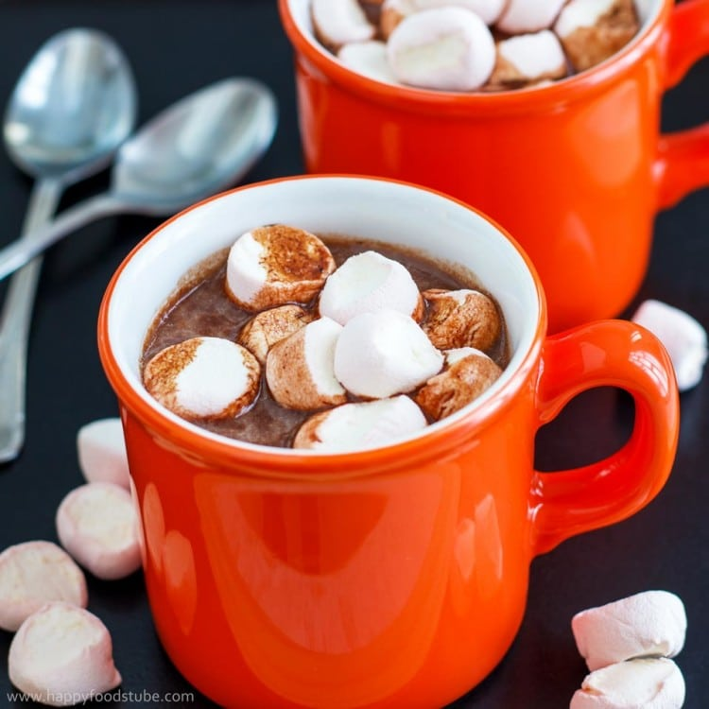
Skill Development/Guided Practice
CFU 1
Which object has higher thermal energy?
Describing Heat Transfer
Identify the object with higher thermal energy. State the direction of energy transfer. Describe what will happen to the temperature of the objects.
You put a marshmallow into your hot chocolate.
CFU 2
Which way will energy be transferred?
The _____ has higher thermal energy and will transfer heat to ____________. The ________ gains heat from the _______ until they are the same temperature.
CFU 3
What will happen to the temperatures of the objects?

Slide 12
Relevance
Knowing how thermal energy moves from one object to another will help you explain why some objects warm up or cool down, and why hot objects lose heat until they reach ‘room temperature’.

Slide 13
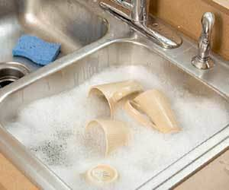
Skill Closure
What is thermal (heat) energy?
Skill Closure
Which way does heat energy flow between objects?
Skill Closure
Describing Heat Transfer
Identify the object with higher thermal energy. State the direction of energy transfer. Describe what will happen to the temperature of the objects.
Explain what happens to the temperatures when a stack of cups are put into a sink of hot water.

Slide 14
Independent Practice
Complete the questions below on your device or in your book.
What is the definition of thermal energy?
What happens to the space between particles in objects as they gain more thermal energy?
What is meant by the phrase ‘thermal equilibrium’? Give an example.
For the situation below, identify and describe three examples of heat transfer to achieve thermal equilibrium.
On a hot day, you decide to go to the beach. As you are walking down the street, you feel the Sun’s warmth on your back. You kick off you thongs and run down the hot sand to the water. When you reach the cold water, you start to shiver as you get in. After 30 minutes of swimming, you get out of the water and lie on your towel to dry off.
The _____ has higher thermal energy and will transfer heat to ____________. The ________ gains heat from the _______ until they are the same temperature.
Describing Heat Transfer
Identify the object with higher thermal energy. State the direction of energy transfer. Describe what will happen to the temperature of the objects.

